Slide 1
VFD “Like” DC Motor
Training Setup for Ignition Scada
Nicholas Robinson
15th May2020

Slide 2
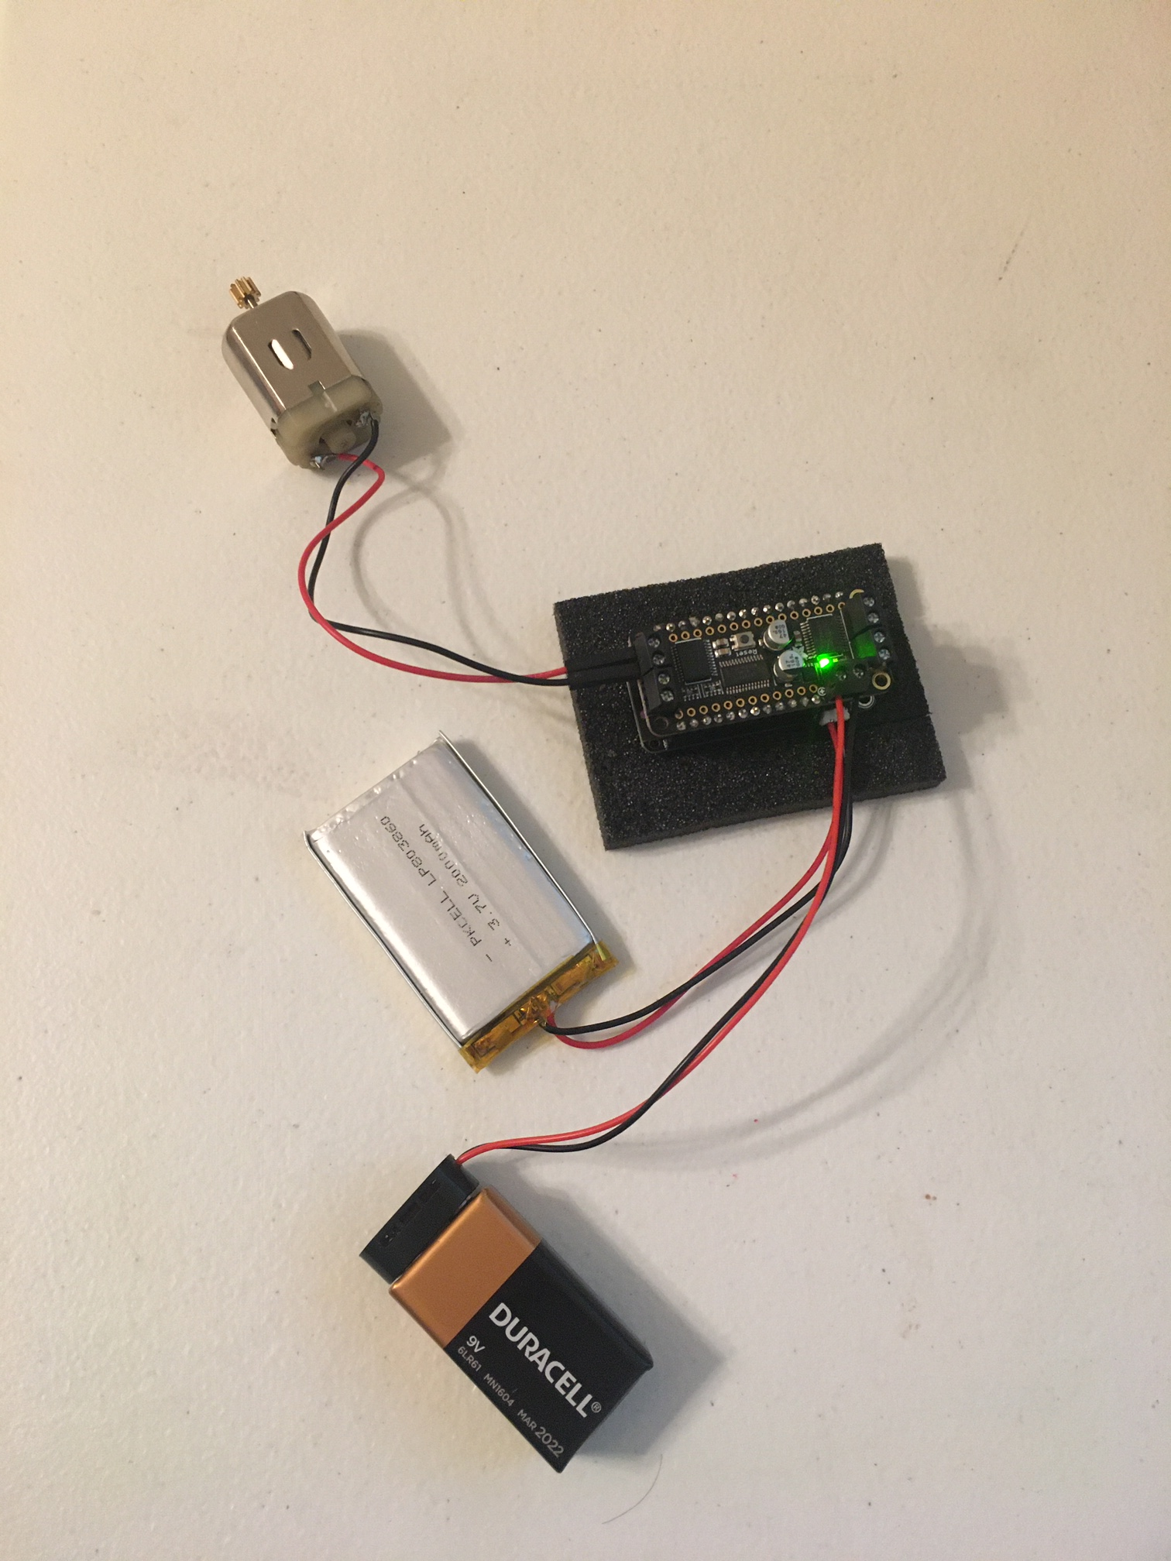
Hardware
Adafruit ESP32 Feather
https://www.adafruit.com/product/3619
Adafruit Feather Motor
https://www.adafruit.com/product/2927
DC motor
9V battery harness
LiPo battery (optional)

Slide 3
Needed Arduino Libraries
Adafruit Motorshield V2 Library
https://github.com/adafruit/Adafruit_Motor_Shield_V2_Library
Modbus-esp8266
https://github.com/emelianov/modbus-esp8266

Slide 4
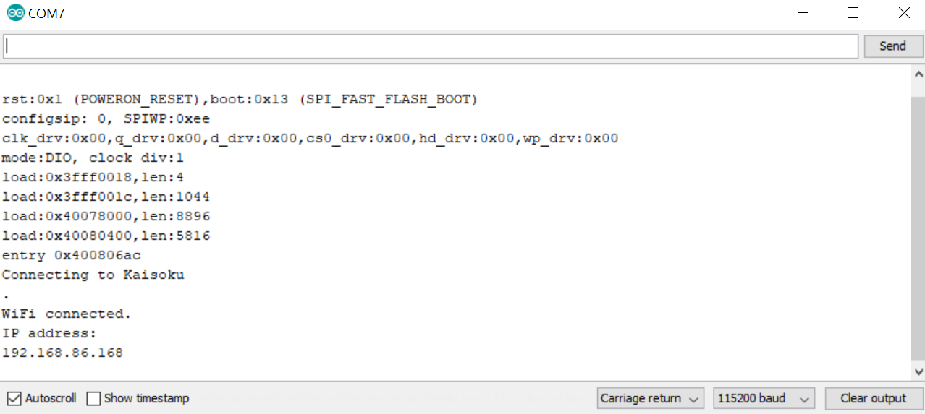
Get IP Address from serial monitor
After programming and while connected to serial, press reset on the board and wait for the IP address to appear

Slide 5
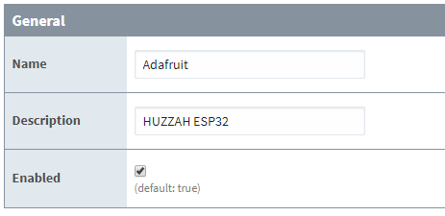
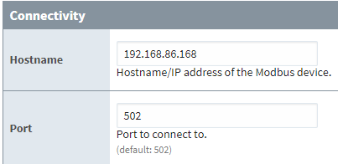

Gateway Device Settings

Slide 6
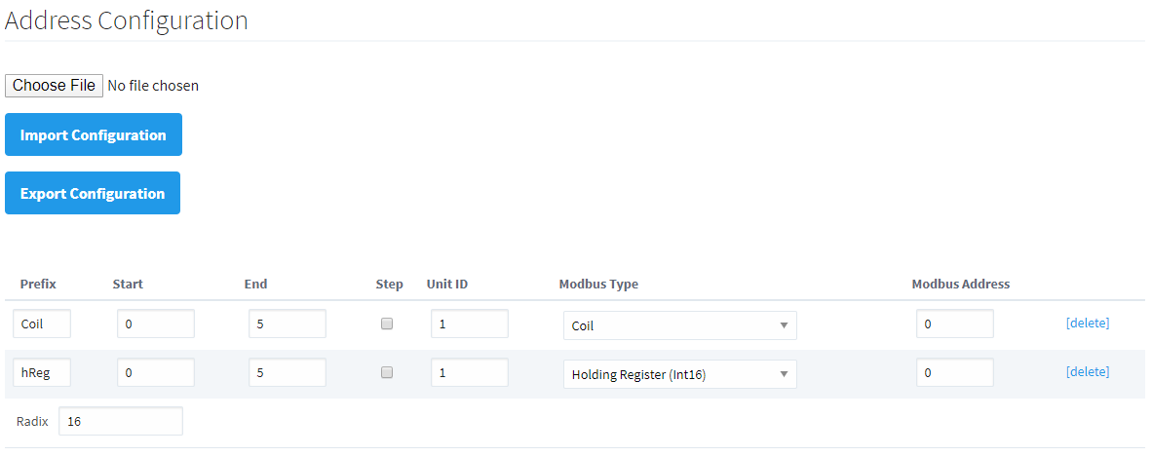
Address Mapping

Slide 7
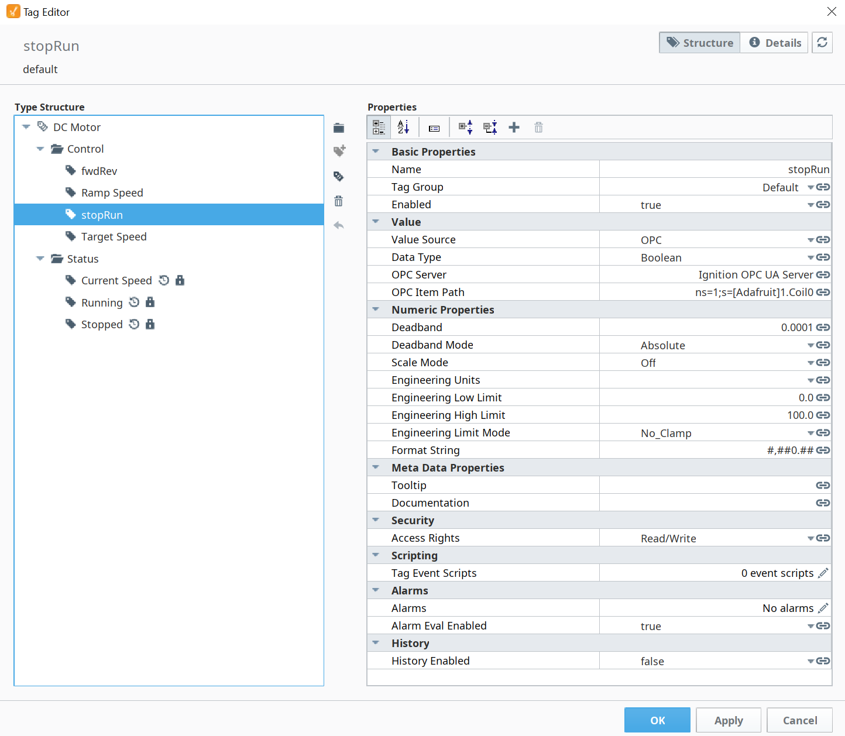
User Data Type

Slide 8
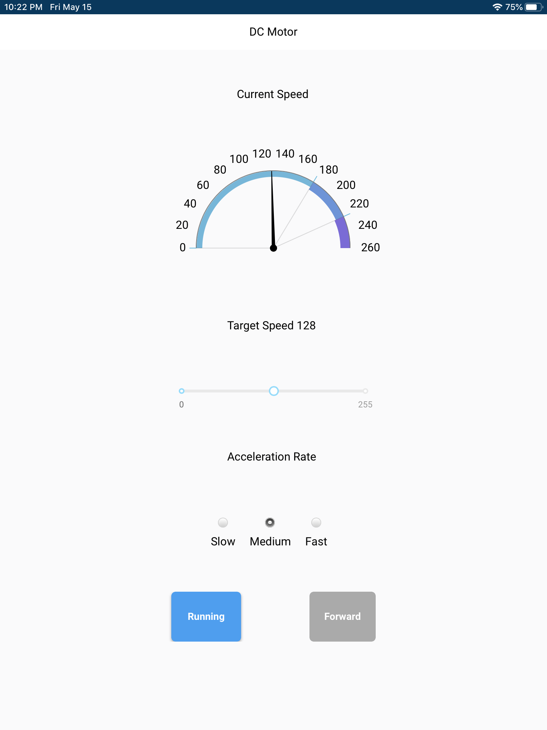
Control View
Current speed is not actual RPM, just for simulation
Slider is bound to Target Speed
Radio buttons with values 50, 25, and 1 are bound to Ramp Speed
Buttons are bound to run/stop and fwd/rev

Slide 9
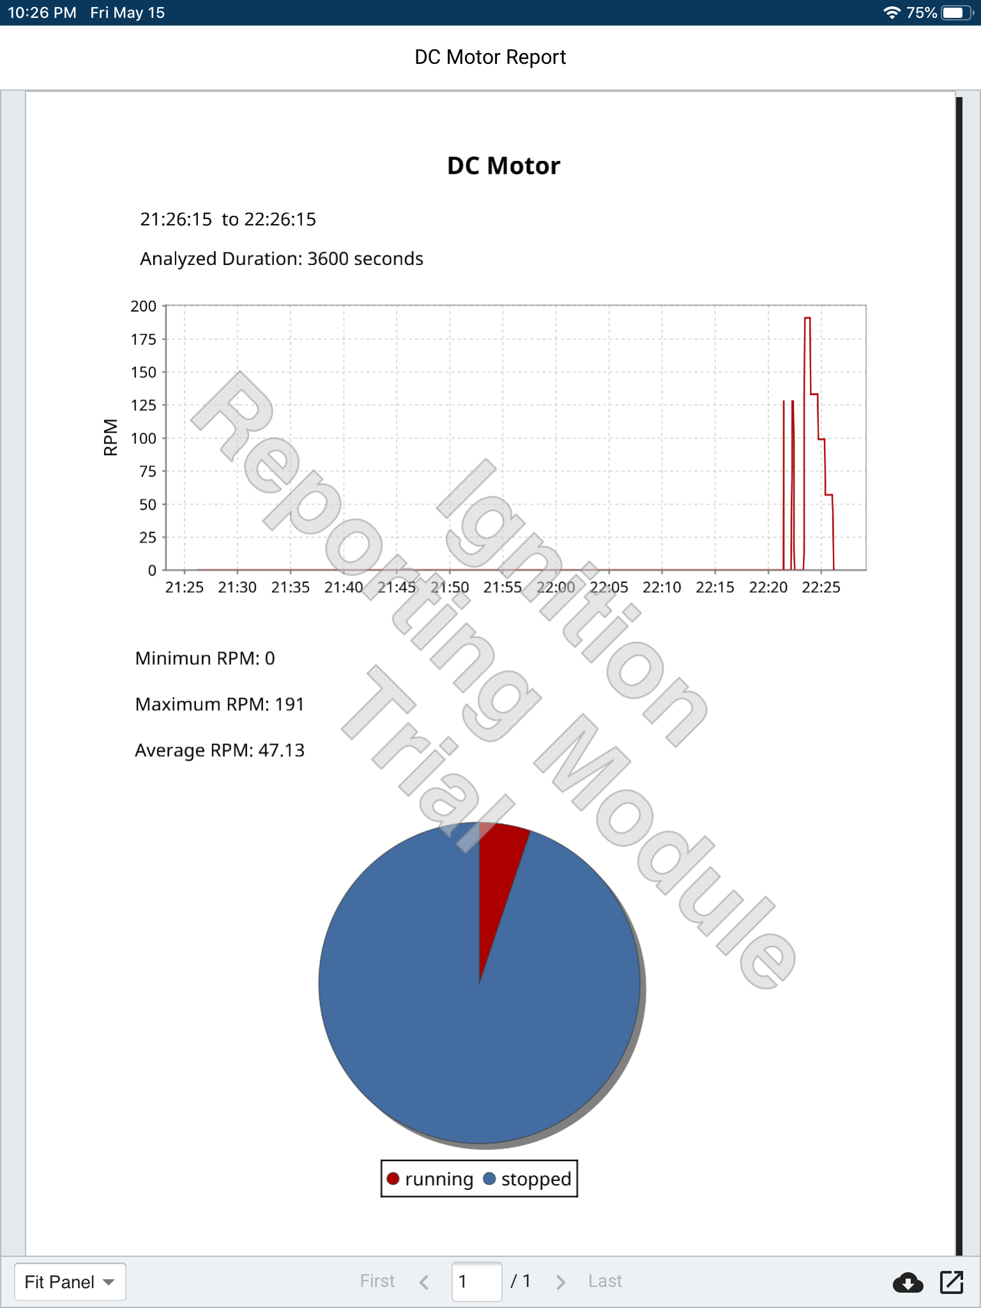
Report

